Slide 1
EE746 Neuromorphic Engineering Lecture 2b: Action Potential
Udayan Ganguly
udayan@ee.iitb.ac.in
Jan, 24, 2020
Lectures follow Purves Chapter 3-4; Please read;
I will provide a few practice questions as well next week in addition to simulations to support the reference!

Slide 2
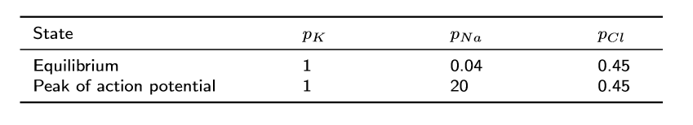
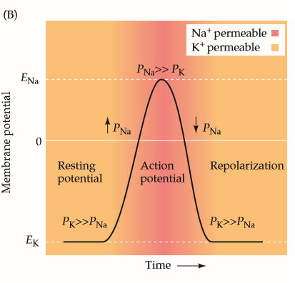
Origin of a spike
The modulation of relative permeability would produce a switching in the potential.
This could lead to spikes.
Done: V modulation is feasible?
Next: Who/How controls spikes?

Slide 3
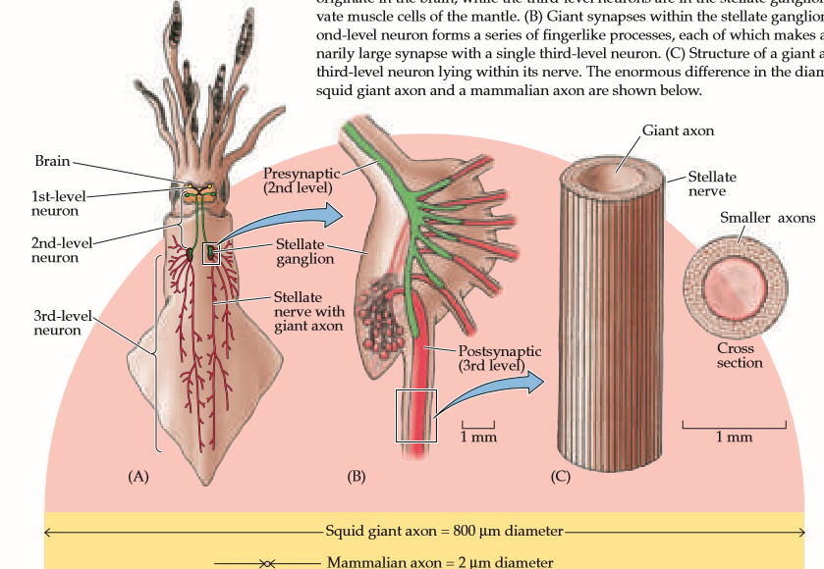
Giant Squid
The squid giant axon is the very large (up to 1 mm in diameter; typically around 0.5 mm) axon that controls part of the water jet propulsion system in squid. It was first described by L. W. Williams^{[1]} in 1909. In 1930s, English zoologist and neurophysiologist J. Z. Young demonstrated the axon's function.
Provides easy manipulation under microscope – nature ‘s gift to scientists!!

Slide 4
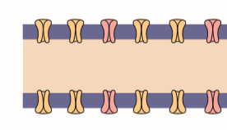
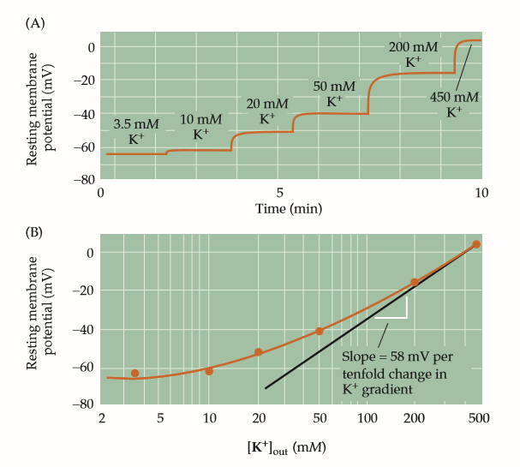
Expt: Resting potential is determined by [K]
[Na]
A
Input:
The [K] in the external environment of the cell can be changed .
How?
Place axon in bath with controlled [K]; Measure potential
Observation:
As [K] increases, the resting potential changed as predicted by Nernt’s equation.
Conclusion: [K] indeed controls resting potential
[K]
V
Question: How does it match with Nernt’s equation?

Slide 5
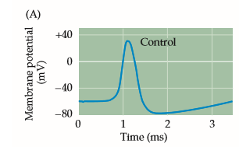
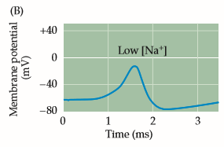
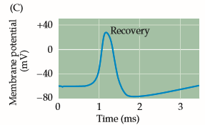
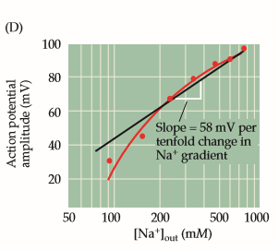
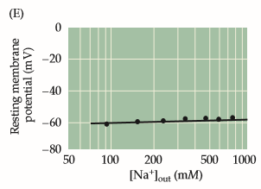
Expt: Peak spike V depends on [Na]
Can we control [Na] dependence?
Similarly increasing reducing [Na]
Again back to initial [Na]
Peak V of spike is modulated by [Na] per Nernt’s equation
[Na]
A
What is the effect of [Na] on resting potential?
[K]
V

Slide 6
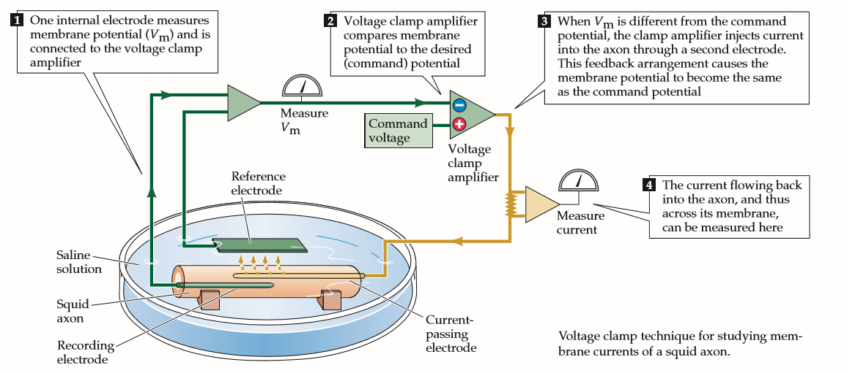
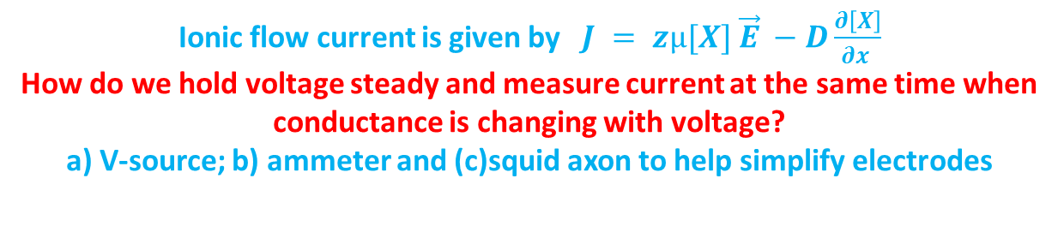
Voltage Clamp Technique
Cole and Marmont 1947
Place axon in bath with controlled [K]; Measure resting potential
Ionic flow current is given by$J = zµ[X] \vec{E} −D\frac{∂\left[X\right]}{∂x }$
How do we hold voltage steady and measure current at the same time when conductance is changing with voltage?
a) V-source; b) ammeter and (c)squid axon to help simplify electrodes
Notes:
Spikes occur because conductance of various ion channels are voltage dependent to produce a spike in time domain. Conductance of membrane is V dependent. So V- change will change current and also Voltage. Can you draw the simplified circuit?
What is the potential difference between electrodes inside the neuron?
Can any current flow through green wires?
Is there any error in the circuit? Where is the current flowing?
https://en.wikipedia.org/wiki/Voltage_clamp#/media/File:Tevcimage.jpg

Slide 7
Voltage Clamp Technique
Place axon in bath with controlled [K]; Measure resting potential
What is the potential difference between electrodes inside the neuron?
Can any current flow through green wires?
Is there any error in the circuit? Where is the current flowing?
Notes:
Spikes occur because conductance of various ion channels are voltage dependent to produce a spike in time domain. Conductance of membrane is V dependent. So V- change will change current and also Voltage. Can you draw the simplified circuit? https://en.wikipedia.org/wiki/Voltage_clamp#/media/File:Tevcimage.jpg
The error is that the current from the Voltage clamp amplifier has no place to go. Everywhere it sees a high-impedance terminal (virtually an open circuit). So there reference (which can be ground) should have a low impedance path to ground. See corrected circuit in the next page.

Slide 8
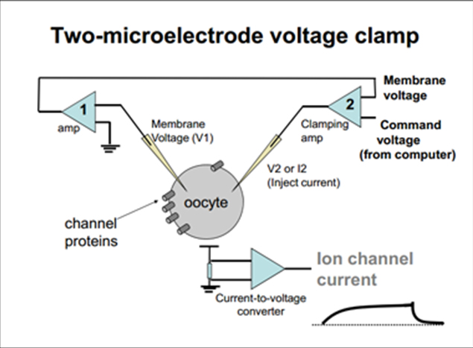
A better circuit
https://en.wikipedia.org/wiki/Voltage_clamp
So we can apply a voltage and measure the current to sustain it i.e DC measurement

Slide 9
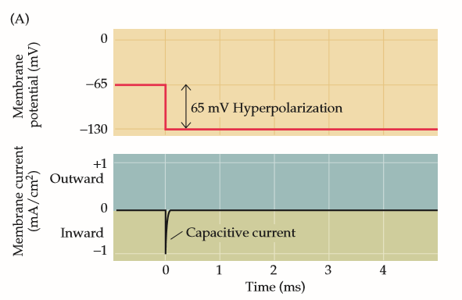
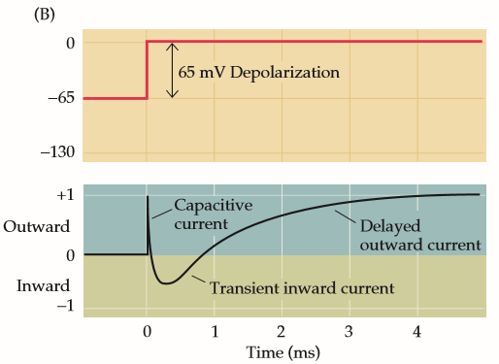
Voltage Clamp Technique
[Na]
A
Ionic flow current is given by $J = zµ[X] \vec{E} −D\frac{∂\left[X\right]}{∂x }$
V
[K]
For negative potential, a simple RC current spike flows
Only for positive potential, a complex time dependent current flows
What do we suspect as cause of current direction change?
Notes:
With negative membrane potential a negative current flows as expected. This is capacitor like behaviour. On application of positive voltage a different behaviour is obtained. Initial a capacitor like current flows. However the current goes negative for a while before coming to the positive value. This means that sodium initially comes in and then K starts going out. Why this behaviour of the channels? Lets study that.

Slide 10
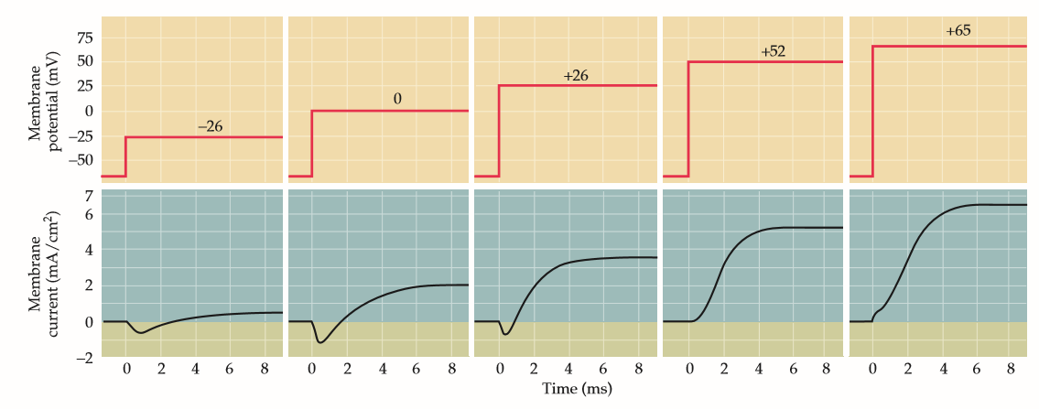
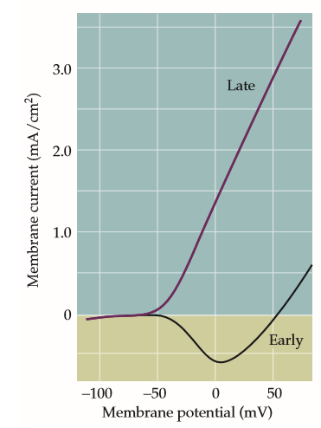
Response of membrane to Bias
Voltage dependent current flow with “interesting/ confusing” transient
Observation | Cause (based on sign on ionic current)
The early negative current increases and then decreases; | Negative Current=[Na+] goes/diffuses in
The late positive current is monotonic | Positive Current =[K+] goes diffuses out
Does the [Na] current saturate or die?
+
-
How can we test the hypothesis?
+
K⁺
-
Na⁺
Can we disable an ionic current selectively e.g. Na or K?
+
-
+
-
Notes:
This how the current responds to the increasing voltage. The final current scales approximately proportional to the applied voltage. The contribution of each channel needs to be tested by disabling the channels selectively.

Slide 11
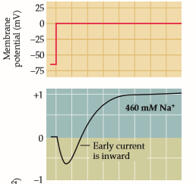
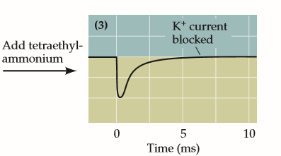
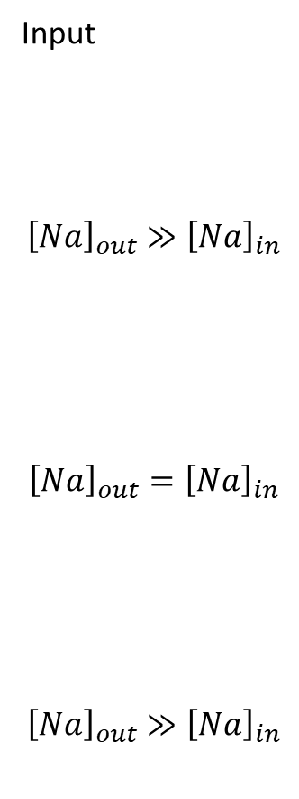
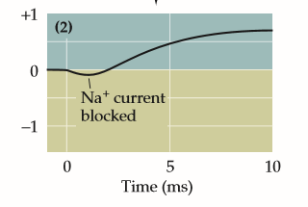
Modulating the response
Input
$${\left[Na\right]}_{out}≫{\left[Na\right]}_{in}$$
$${\left[Na\right]}_{out}={\left[Na\right]}_{in}$$
$${\left[Na\right]}_{out}≫{\left[Na\right]}_{in}$$
What would happen if we could disable the V-dependent [Na] or [K] channels ?
Add tetrodotoxin
Notes:
Tetrodotoxin, an alkaloid neurotoxin found in certain puffer fish, tropical frogs, and salamanders, blocks the Na+ current without affecting the K+ current. Conversely, tetraethylammonium ions block K+ currents without affecting Na+ currents. The differential sensitivity of Na+ and K+ currents to these drugs provides strong additional evidence that Na+ and K+ flow through independent permeability pathways.
Writing in 1950, Graham made some observations on the toxic effects of tetraethylammonium bromide in humans. In one subject, described as a "healthy woman", 300 mg of tetraethylammonium bromide, i.v., produced incapacitating "curariform" (i.e., resembling the effects of tubocurarine) paralysis of the skeletal muscles, as well as marked drowsiness. These effects were largely dissipated within 2 hours.
[Wikipedia]

Slide 12
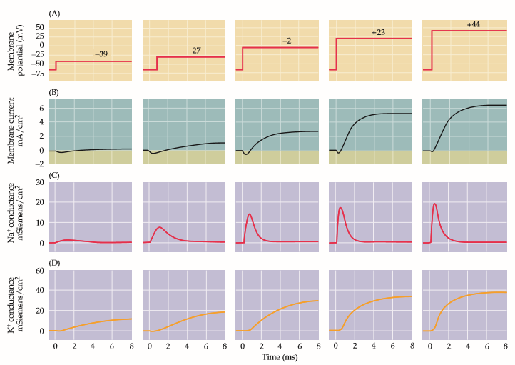
Studying either [K] or [Na] currents
What is the difference between Na and K channel response to bias?
Qualitatively & Quantitatively (timescale, peak conductance) vs input
Na channel behavior: Activates and deactivates quickly
K channel: Activates slowly to saturation
Notes:
The currents carried by Na+ and K+—INa and IK—could be determined separately from recordings of the membrane currents resulting from depolarization (Figure 3.6B) by measuring the difference between currents recorded in the presence and absence of external Na+ (as shown in Figure 3.4).

Slide 13
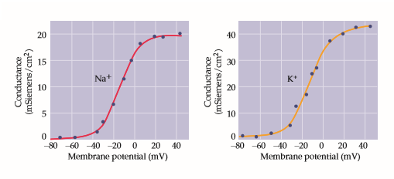
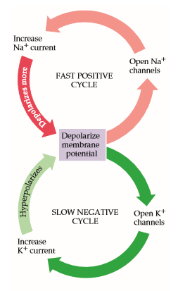
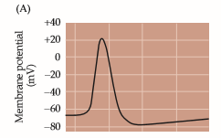
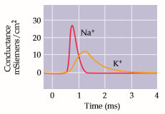
K vs. Na channel V dependent conductance
Measured Peak conductance vs bias
Same spike shape is observed despite different inputs.
Input independent after some initial stage
So how does it produce the spike?
Time dynamics & magnitude are different for K and Na channels
Which is positive feedback system Na or K? i.e. it snowballs; Conversely which is negative feedback?
Notes:
Sodium starts off fast. Quickly opens and quickly shuts. Then potassium opens and reaches a saturation value. When potassium conductance is higher it exceeds sodium conductance for spike to come back. It high voltage sodium channel shuts off.
One of these have a positive feedback and other has a negative feedback. As voltage goes up, sodium ion conductance increases, more sodium comes in, voltage increases, even more sodium comes in (positive feedback). It is negative feedback for potassium. Increased voltage increases potassium conductance which decreases the voltage
Why does the system not trigger again?-->
Because it requires initial stimulus for Na to take up the positive feedback. Input just gives it the initial push. Later part is done by the channels themselves

Slide 14
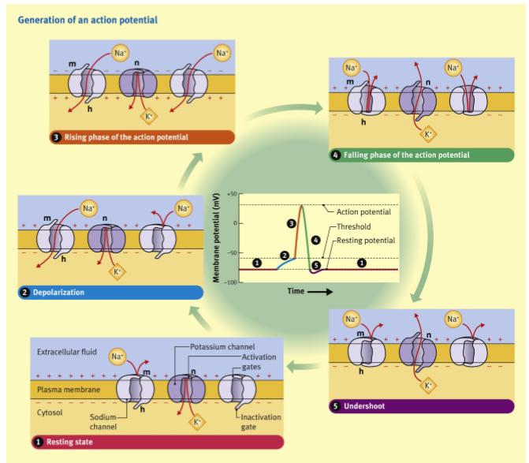

Spike
Nobel Prize 1963
Notes:
Hudgkin and Huxley gave this channel conductance model for neuron spike response.

Slide 15
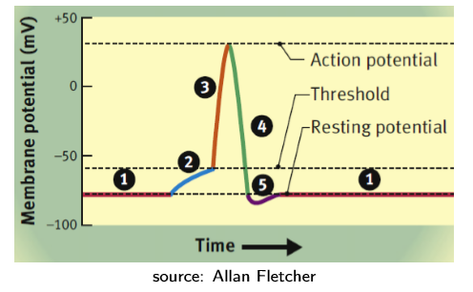
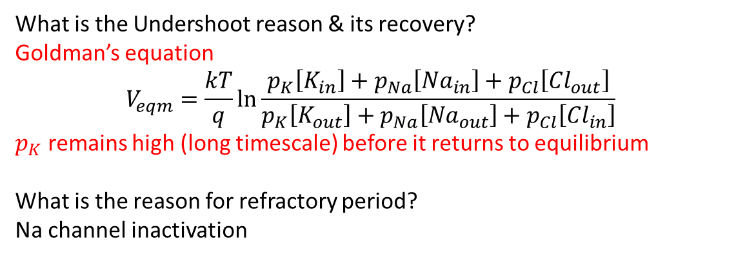
Undershoot and Refractory Period
What is the Undershoot reason & its recovery?
Goldman’s equation
$$V_{eqm}=\frac{kT}{q}\ln{\frac{p_{K}\left[K_{in}\right]+p_{Na}\left[{Na}_{in}\right]+p_{Cl}\left[{Cl}_{out}\right]}{p_{K}\left[K_{out}\right]+p_{Na}\left[{Na}_{out}\right]+p_{Cl}\left[{Cl}_{in}\right]}}$$
$p_{K}$ remains high (long timescale) before it returns to equilibrium
What is the reason for refractory period?
Na channel inactivation
Notes:
The K does not switch off as soon as the resting potential is hit. Therefore some more K ions move out of the neuron thus decreasing the potential even further. This slowly closes and voltage is restored to the final resting value. This is the reason for the refractory period. This makes sure that spike frequency does not increase beyond a limit.

Slide 16
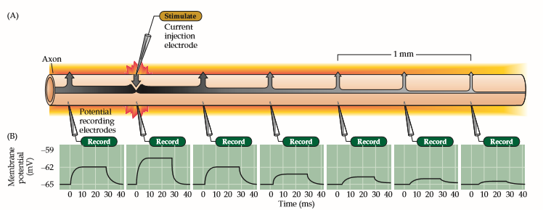
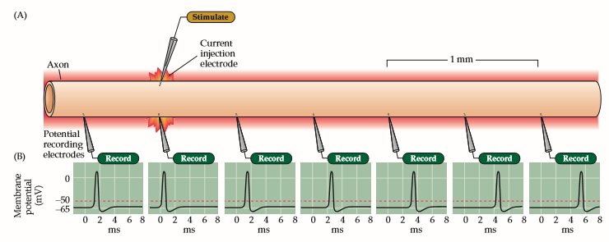
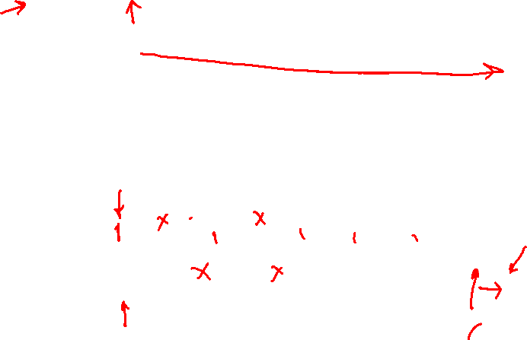
Sub-threshold vs above threshold input
Mark the direction of signal transport
Decaying signal
Propagating signal
Notes:
Ordinary signal does not propagate but spike propagates. Spike voltage causes the sodium channels to open while travelling. There is not delay as every spike has the same shape now. Previous channels do not fire because they are in refractory period. This makes the spike move forward maintaining its shape.

Slide 17
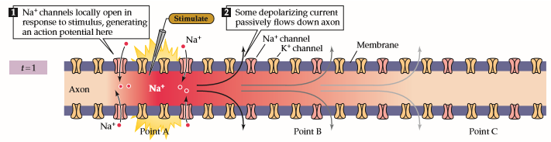
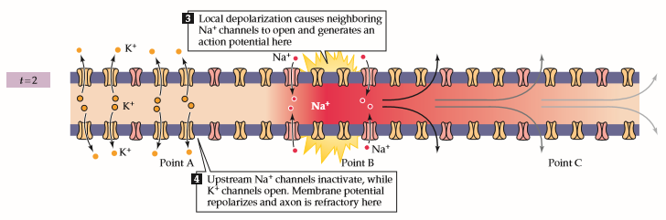
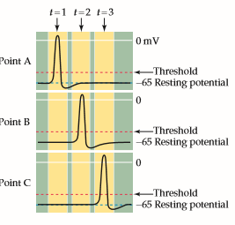
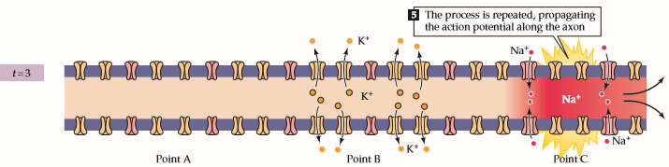
How does Spike Travel through axon?
Its like a chain reaction.
Is this directional?
Think of an analogy
Notes:
A solution to propagate signals over long distance is myelination. Regions on the axons are locked out where there are no channels. This saves energy as no opening or closing of channels happens here. In this region we do not lose ions and charge is conserved inside the neuron. Myelin causes 10x faster propagation.

Slide 18
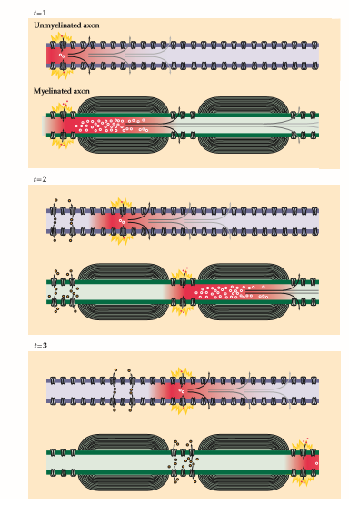
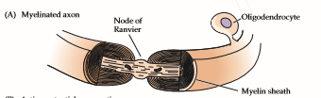
How to increase the speed of axon transport?
Large axons
Or
Mylenation
Notes:
By acting as an electrical insulator, myelin greatly speeds up action potential conduction (Figure 3.14). For example, whereas unmyelinated axon conduction velocities range from about 0.5 to 10 m/s, myelinated axons can conduct at velocities of up to 150 m/s. The major reason underlying this marked increase in speed is that the time-consuming process of action potential generation occurs only at specific points along the axon, called nodes of Ranvier, where there is a gap in the myelin wrapping (see Figure 1.4F).
If the entire surface of an axon were insulated, there would be no place for current to flow out of the axon and action potentials could not be generated. As it happens, an action potential generated at one node of Ranvier elicits current that flows passively within the myelinated segment until the next node is reached. This local current flow then generates an action potential in the neighboring segment, and the cycle is repeated along the length of the axon. Because current flows across the neuronal membrane only at the nodes (see Figure 3.13), this type of propagation is called saltatory, meaning that the action potential jumps from node to node.

Slide 19
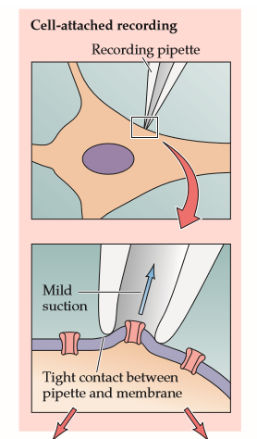
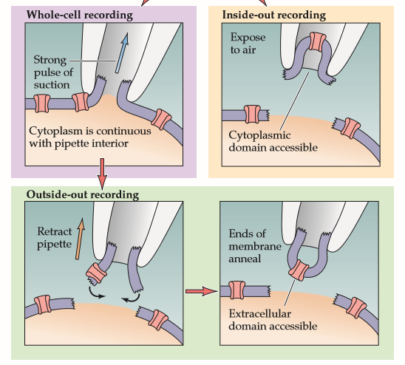
Patch Clamp Technique
Can we characterize single channels?
Can we characterize single channels?

Slide 20
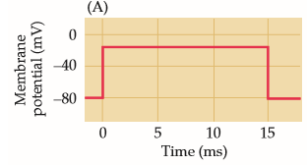
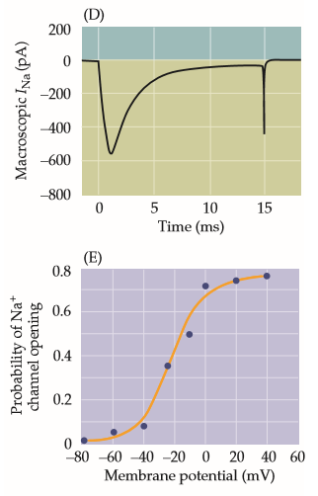
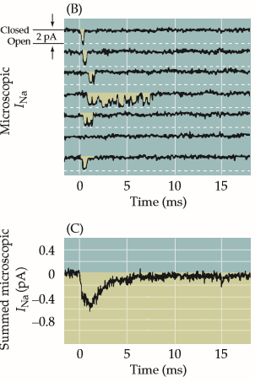
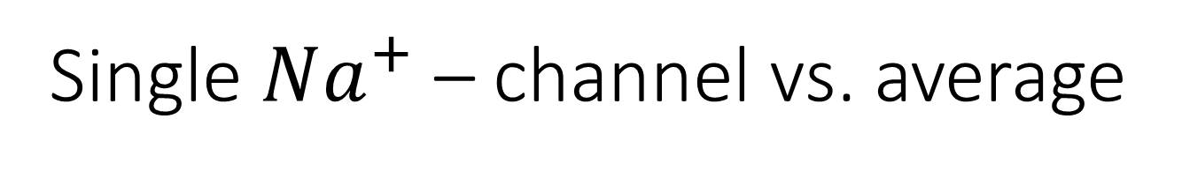
Single $Na^{+}$ – channel vs. average
Stochastic behavior of single channel produces a well behaved behavior with averaging

Slide 21
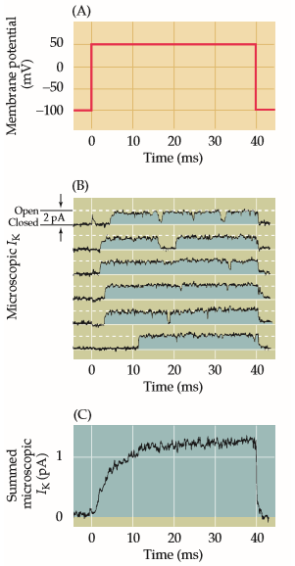
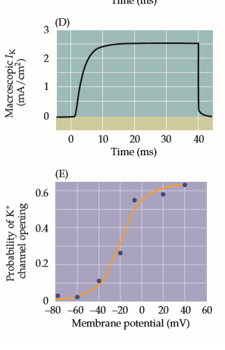
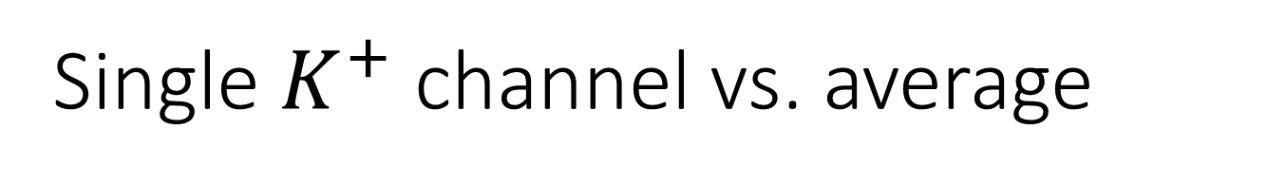
Single $K^{+}$ channel vs. average
Stochastic behavior of single channel produces a well behaved behavior with averaging

Slide 22
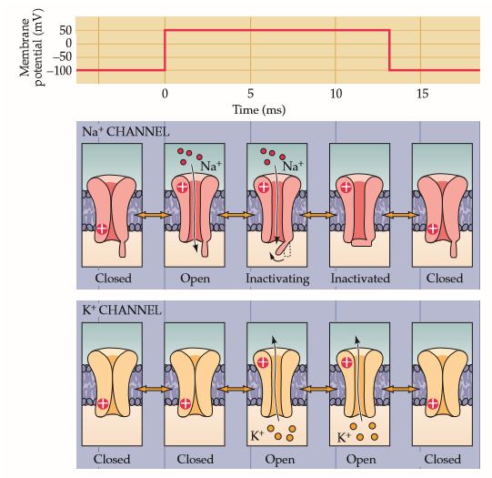
Molecular basic of ion channels
Draw the Ion channel current vs. time

Slide 23
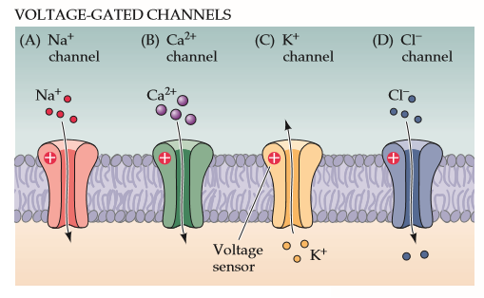
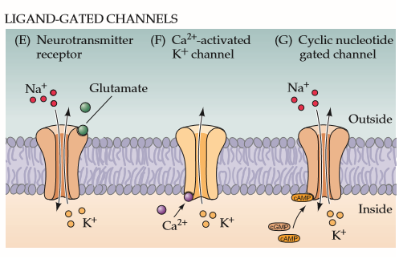
Voltage vs. Ligand gated Channel
There is stretch and heat activated channels. What are they used for?
What other activations are possible?

Slide 24

Pumps and Exchangers

Slide 25


Voltage gated Channel

Slide 26

Modes of communication: V-Spike & Chemical)

Slide 27

Disease
A defect in brain Na+ channels causes generalized epilepsy with febrile seizures (GEFS) that begins in infancy and usually continues through early puberty.
Numerous genetic disorders affect the voltage-gated channels of skeletal muscle and are responsible for a host of muscle diseases that either cause muscle weakness (paralysis) or muscle contraction (myotonia).

Slide 28
Next Step
Develop Mathematical model for Spiking Neuron

